Slide 1
International Baccalaureate introduction
Mr. benson – ib coordinator and instructor

Slide 2
IB Mission statement
The International Baccalaureate aims to develop inquiring, knowledgeable and caring young people who help to create a better and more peaceful world through intercultural understanding and respect.
To this end the organization works with schools, governments and international organizations to develop challenging programmes of international education and rigorous assessment.
These programmes encourage students across the world to become active, compassionate and lifelong learners who understand that other people, with their differences, can also be right.

Slide 3
Ideal ib candidate profile
Maintains a successful academic record
Participates in many aspects of school life
Has good time management skills
Has a positive attitude towards learning
Willing to work with others
Willing to take initiative

Slide 4
IB diploma programme overview
The International Baccalaureate® (IB) Diploma Programme (DP) is designed for highly motivated students interested in earning the IB Diploma, or individual IB Courses, in addition to their high school diploma. Students enter the two-year Diploma Programme as a high school junior.
IB offers high quality programmes of international education to a worldwide community of schools. The Programme began in 1968 as a non-profit education foundation. It was designed to provide a consistent education for internationally minded students preparing for college, by providing a common curriculum and common assessments.

Slide 5
IB diploma programme overview
IB Programmes promote the education of the whole person, emphasizing intellectual, personal, emotional and social growth through all domains of knowledge. The IB approach is interdisciplinary and requires students to apply learning in one course to learning in another. Students learn to transfer critical and conceptual thinking from one situation to the next.
Additionally, the curriculum encourages the study of international perspectives so students are prepared to navigate the increasingly global marketplace. Today, there are more than 1,101,000 IB students in 3,584 schools in 145 countries.

Slide 6
IB programme at qsi chengdu
QSI International School of Chengdu was granted authorization to offer the International Baccalaureate Diploma Program (IBDP) in May 2015. QSI Chengdu offers a varied range of IBDP subjects from which students can tailor study programs that best suit their immediate needs, personal interests and future goals. The current IB course offerings for students at QSI Chengdu are listed on the following slides.

Slide 7
IB programme requirements
To be awarded the IB diploma, students must satisfy the course requirements in one course from each of the six groups listed. At least three and not more than four courses are taken at higher level (HL—240 hours over two years), the others at standard level (SL—150 hours over two years).
Additionally, students must complete a Theory of Knowledge (TOK) component which is designed to foster critical reflection on students’ own knowledge and experience; a program of Creativity, Action, and Service (CAS); and an extended essay (EE) of 4,000 words on a topic of personal interest.

Slide 8
Ib diploma programme model
6 Core Subjects
Extended Essay
ToK
CAS

Slide 9
Ib diploma programme model
Group 1:
IB English A
Language and Literature (HL and SL) Instructor:

Slide 10
Ib diploma programme model
Group 2:
Language B
Mandarin (HL and SL) Instructor: Lizzie Li

Slide 11
Ib diploma programme model
Group 3:
Individuals & Societies
History (HL and SL) Instructor: John Gunther
Psychology (SL) Instructor: Ryan Benson

Slide 12
Ib diploma programme model
Group 4: Sciences
Biology (HL and SL) Instructor: Chris Alpiar
Chemistry (HL and SL) Instructor: Anne O'Connell
Physics (HL and SL) Instructor: Kevin Smith

Slide 13
Ib diploma programme model
Group 5: Mathematics
Mathematics (HL and SL) Instructor: Todd Miller
Mathematical Studies (SL) Instructor: Kevin Smith

Slide 14
Ib diploma programme model
Group 6:
The Arts
IB Visual Arts (HL and SL) Instructor: Amanda Barbee

Slide 15
Ib diploma programme model
Core Areas
Theory of Knowledge (TOK) Instructor: Julie Rix
Creativity, Action, Service (CAS) Coordinator: Amanda Barbee
Extended Essay (EE) Instructor: Individually selected teacher coordinators

Slide 16
The IB learner profile
Inquirers
Knowledgeable
Thinkers
Communicators
Principled
Open-minded
Caring
Risk-takers
Balanced
Reflective

Slide 17
The Difference between ap and IB
AP
Opportunity for advanced placement in university
Taken on a course-by-course 1-year basis
Mark is based solely on an end of term AP exam
IB
Opportunity for advanced placement in university
Offers a complete 2-year program and diploma
Marks determined by internal assessments and final IB exams

Slide 18
Academic honesty
International Baccalaureate (IB) programmes encourage students to inquire and to think critically and creatively; students are then asked to give shape to their thinking through oral discussion or presentations, through visual representations and displays, and in multiple forms of writing.
To this point, academic honesty is an essential aspect of teaching and learning in IB programmes where action is based on inquiry and reflection.
Academic honesty is part of being “principled”, a learner profile attribute where learners strive to “act with integrity and honesty” as we question, inquire and act.

Slide 19
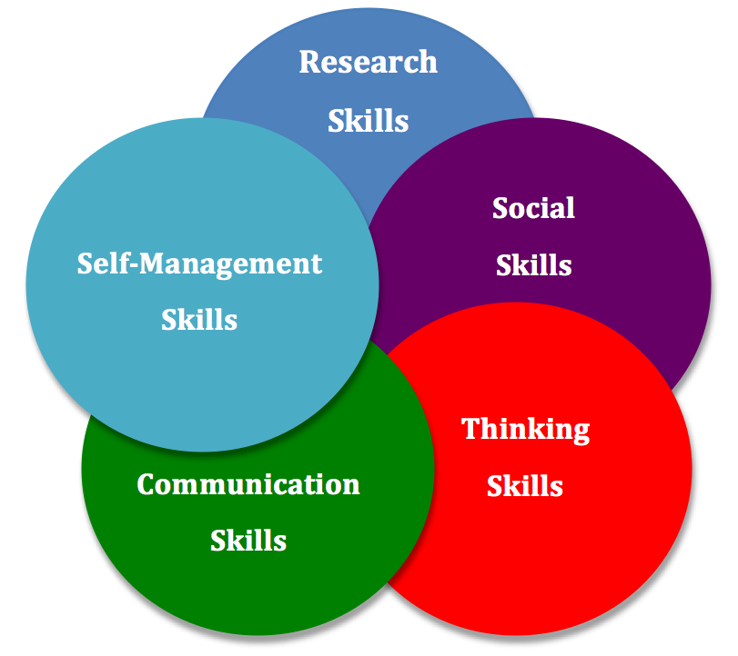
Approaches to Learning (ATL)
Through approaches to learning (ATL) in IB programmes, students develop skills that have relevance across the curriculum and help them “learn how to learn”. The ATL skills are as follows:
• Self-management • Social • Communication • Thinking • Research

Slide 20
Ib diploma programme and college
Research indicates that Diploma Programme (DP) graduates complete college faster than their peers, feel more prepared for college-level coursework involving research, and are better able to cope with demanding workloads and time management challenges.
A 2012 study of Chicago public schools interviewed Diploma Programme alumni and found that students:
felt prepared to succeed and excel in their coursework
had strong academic skills, especially related to analytical writing
learned academic behaviors like work ethic, motivation, time management, and help-seeking that were sources of strength in the transition to college-level work
identified preparation in the IB programme as the source of their success as college students.

Slide 21
The DP curriculum prepares students for college
A 2009 study looked at the standards for seven Diploma Programme courses and compared them to a set of standards for college-readiness.
Researchers found:
a high degree of alignment with college readiness standards in all subject areas
many individual IB standards were more advanced than those required for success in entry-level college courses
IB standards address key cognitive strategies (critical thinking, intellectual inquisitiveness and interpretation skills) that have been identified by college instructors as necessary for college success.

Slide 22
IB students more likely to succeed in college
A 2010 study that looked at performance on IB exams and college GPA of over 1500 IB students enrolled in the University of California system found:
IB students earned higher GPAs and graduated at higher rates than a matched comparison group. This held across all family income levels
performance in the Diploma Programme was the strongest predictor of college GPA.

Slide 23
IB students more likely to succeed in college
“IB is well known to us as excellent preparation. Success in an IB programme correlates well with success at Harvard. We are pleased to see the credential of the IB Diploma Programme on the transcript.”
Marlyn McGrath Lewis, Assistant Dean of Admissions, Harvard University, USA
“The IB is a first-rate programme, one we are familiar with, and it prepares students well for a university like ours.”
Fred Hargadon, Director of Undergraduate Admissions, Princeton University

Slide 24
IB students more likely to succeed in college
“We respect the IB programme for its academic rigour and the dedication it requires of students to earn the diploma. Over the years, we have found IB students to be exceptionally well-prepared for a challenging college experience.”
Lorne Robinson, Dean of Admission and Financial Aid, Macalester College
“Connecticut College highly values the IB programme as it prepares students in ways that few secondary school curriculums can... Students who have graduated from schools with the IB curriculum are extremely well prepared when they arrive on our campus.”
Martha Merrill, Dean of Admission and Financial Aid, Connecticut College

Slide 25
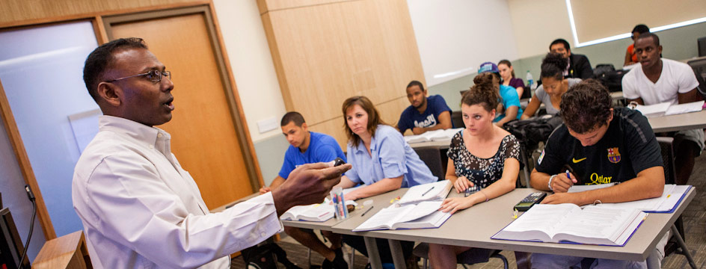
Colleges seek ib students
“We're looking for students who are engagers—students who are maximizing opportunities in the classroom, maximizing opportunities outside of the classroom…
what's very unique about IB is that through its curriculum it allows students to be able to satisfy the requirements of the types of students that we're looking for.”
Kedra Ishop , Vice Provost and Director of Admissions, UT Austin

Slide 26
Statistics from 2012

Slide 28
statistics
The average acceptance rate of IB students into university/college is 22% higher than the average acceptance rate of the total population.
The acceptance rate of IB students into Ivy League institutions (Princeton, Yale, Brown, Harvard, Columbia, Cornell, Dartmouth, University of Pennsylvania) is between 3% and 13% higher compared to the total population acceptance rate.

Slide 29
IB Diploma Program Advantages
Academic - students are accepted into colleges at higher rates than students who are not IB Diploma Candidates and do better once they are there.
Economic – many IB Diploma recipients receive ~18-36 credit hours for college and sophomore standing. Students who do not receive their IB Diploma can still receive college credit for some courses, if they do well enough on the assessments.
88% of IB Diploma Programme graduates achieve a bachelor’s degree within the allotted time upon entering university, compared with 58% of all students.

Slide 30
IB diploma programme testimonial video

Slide 31
Want to know more?
The QSI Chengdu Website has a plethora of information
about the IB Diploma Program!
Check it out:
http://ibqsichengdu.weebly.com/

